Slide 1


CHARITY DONATION SYSTEM
Uday sankar Mukherjee | CSE(AIML) - 38 | 12021002016053
Atrij Paul | CSE(AIML) - 43 | 12021002016063

Slide 2
Introduction
The Web-Based Charity Donation System is a PHP and MySQL-based web application that simplifies the donation process to charitable organizations. Users can create accounts, submit donations, and view a list of donations, while admins can manage donations, users, and monitor the system's overall functionality. It aims to provide a user-friendly platform to manage and track charity contributions in response to the growing trend of online donations.

Slide 3
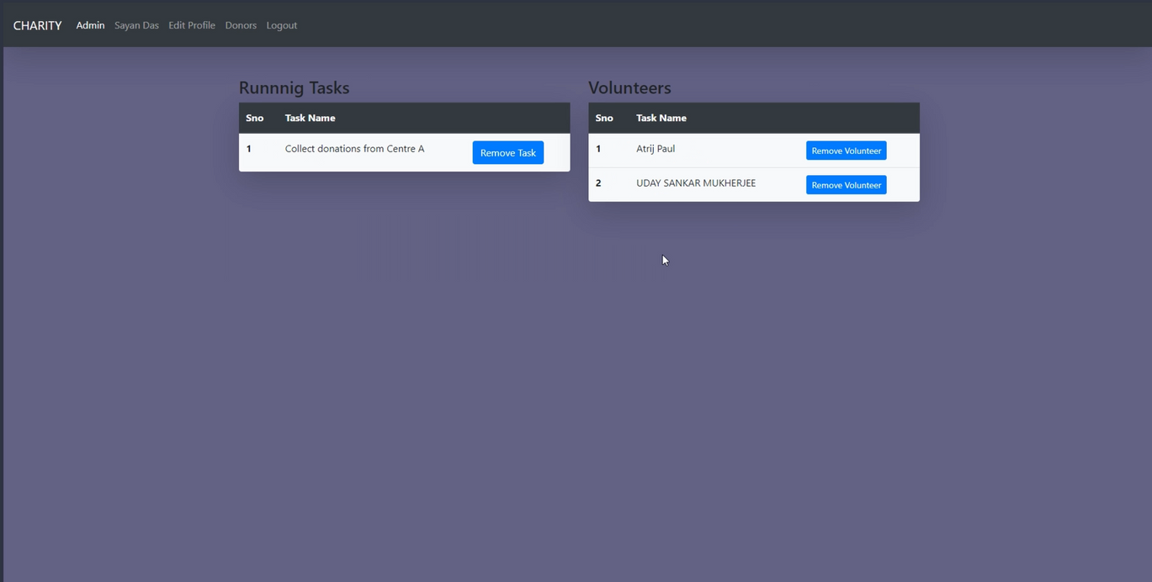
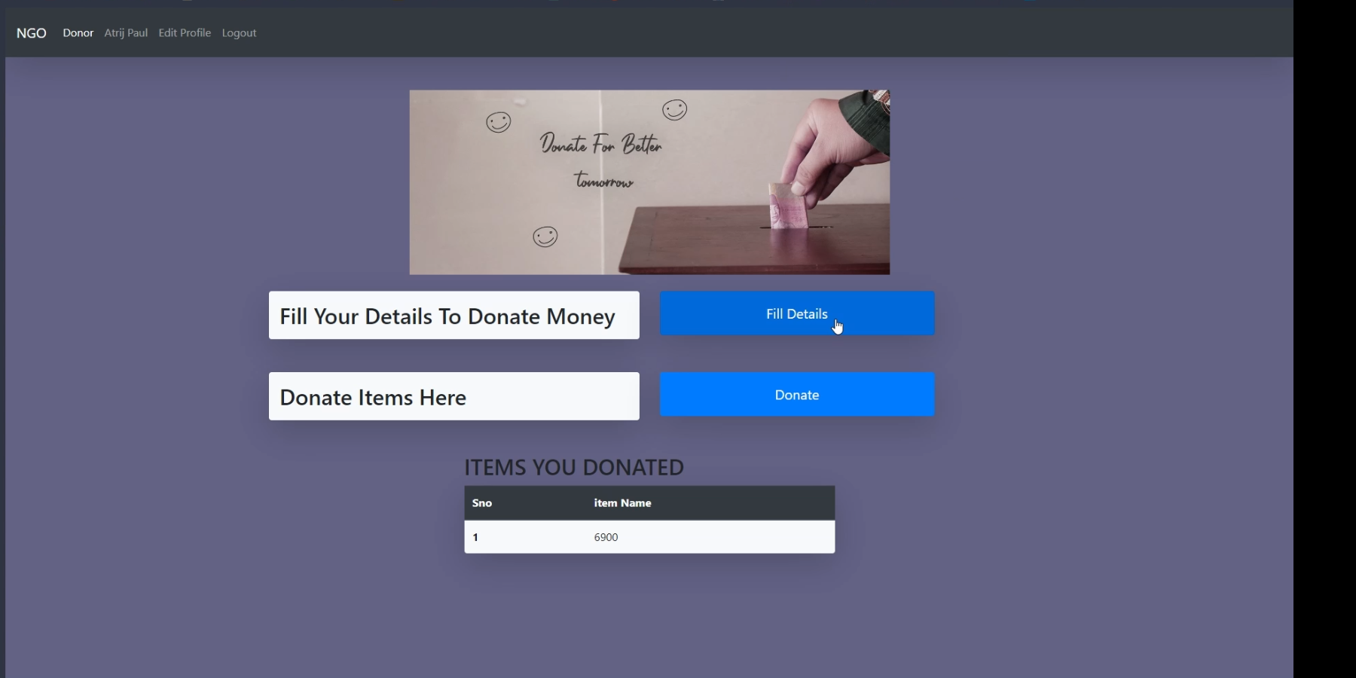
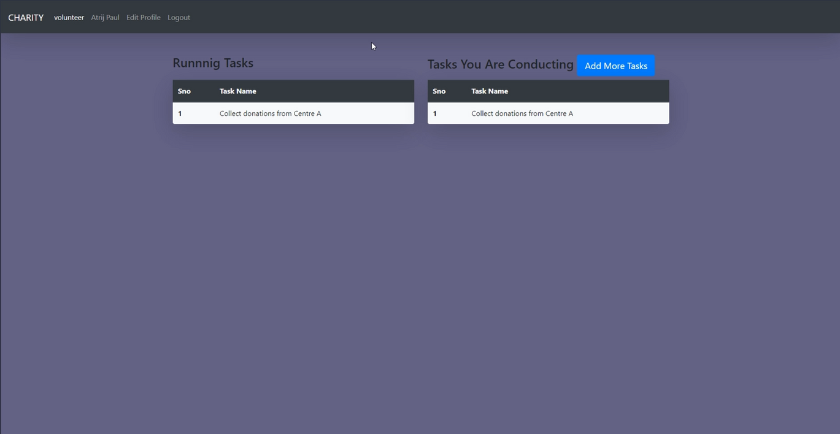
Inside Application
Donor
Volunteer
Features for a donation platform include user registration, authentication, one-time or recurring donations with options to choose amount, frequency, and specific cause or project. Secure payment gateways and email confirmation receipts for successful donations are also important. Additionally, access to donation history with entries including date, amount, recipient, and payment status is beneficial.
Volunteers can create and manage tasks within a charitable organization. They can create tasks such as event planning, fundraising, or outreach, and manage them by viewing, editing, and updating their status. For each task, they can provide details like its name, description, deadline, and priority.
Admin
Admins manage user accounts, donations, and tasks (if applicable). In user management, they can create, edit, and delete accounts, reset passwords, and view profiles. Admins have full access to donation records, can view, edit, or delete entries, and generate donation reports and analytics. If applicable, they can also add, edit, or delete tasks and assign them to specific volunteers.

Slide 4
Inside Application
Admin
Volunteer
Admins manage user accounts, donations, and tasks (if applicable). In user management, they can create, edit, and delete accounts, reset passwords, and view profiles. Admins have full access to donation records, can view, edit, or delete entries, and generate donation reports and analytics. If applicable, they can also add, edit, or delete tasks and assign them to specific volunteers.
Volunteers can create and manage tasks within a charitable organization. They can create tasks such as event planning, fundraising, or outreach, and manage them by viewing, editing, and updating their status. For each task, they can provide details like its name, description, deadline, and priority.
Donor
Features for a donation platform include user registration, authentication, one-time or recurring donations with options to choose amount, frequency, and specific cause or project. Secure payment gateways and email confirmation receipts for successful donations are also important. Additionally, access to donation history with entries including date, amount, recipient, and payment status is beneficial.

Slide 5
Inside Application
Admin
Donor
Admins manage user accounts, donations, and tasks (if applicable). In user management, they can create, edit, and delete accounts, reset passwords, and view profiles. Admins have full access to donation records, can view, edit, or delete entries, and generate donation reports and analytics. If applicable, they can also add, edit, or delete tasks and assign them to specific volunteers.
Features for a donation platform include user registration, authentication, one-time or recurring donations with options to choose amount, frequency, and specific cause or project. Secure payment gateways and email confirmation receipts for successful donations are also important. Additionally, access to donation history with entries including date, amount, recipient, and payment status is beneficial.
Volunteer
Volunteers can create and manage tasks within a charitable organization. They can create tasks such as event planning, fundraising, or outreach, and manage them by viewing, editing, and updating their status. For each task, they can provide details like its name, description, deadline, and priority.

Slide 6
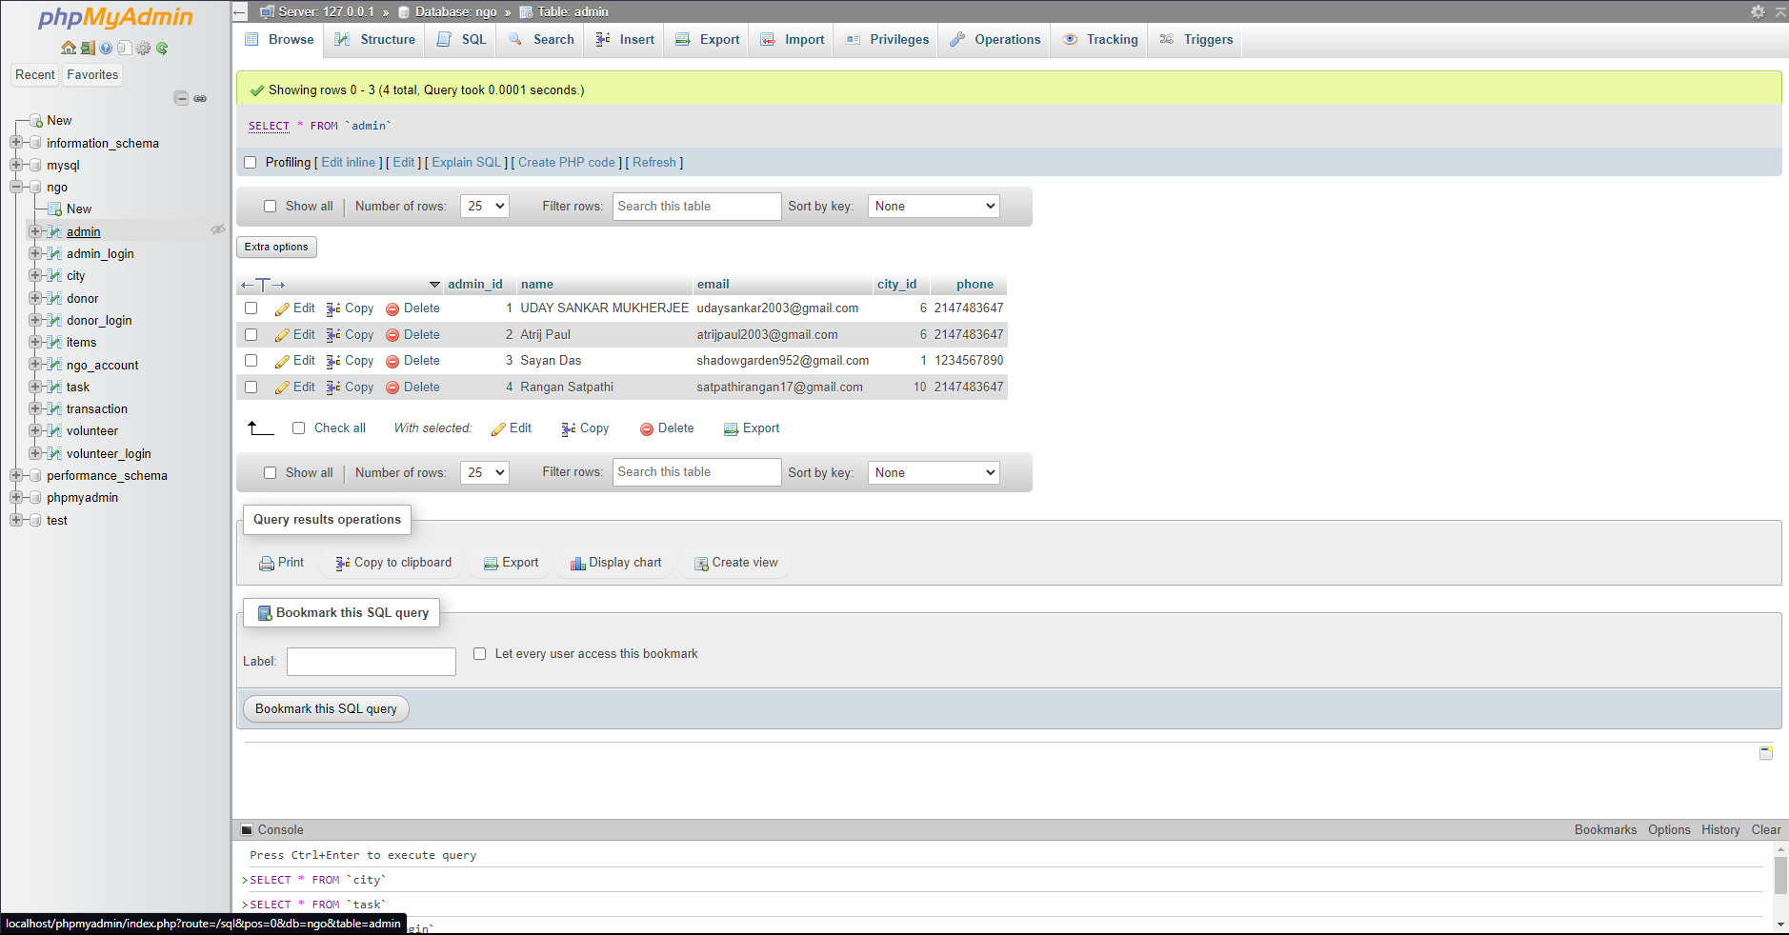
Database

Slide 7
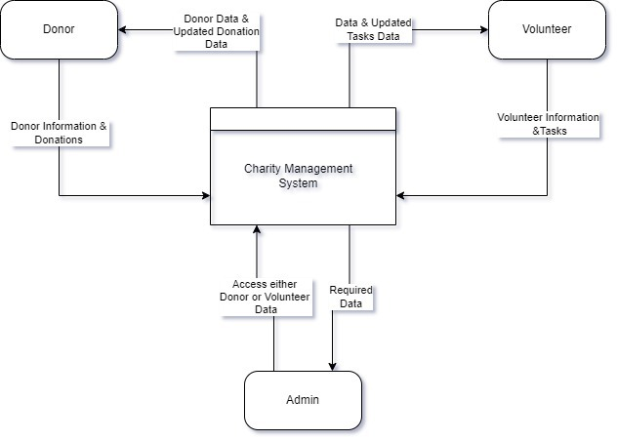
DFD
LEVEL 0

Slide 8
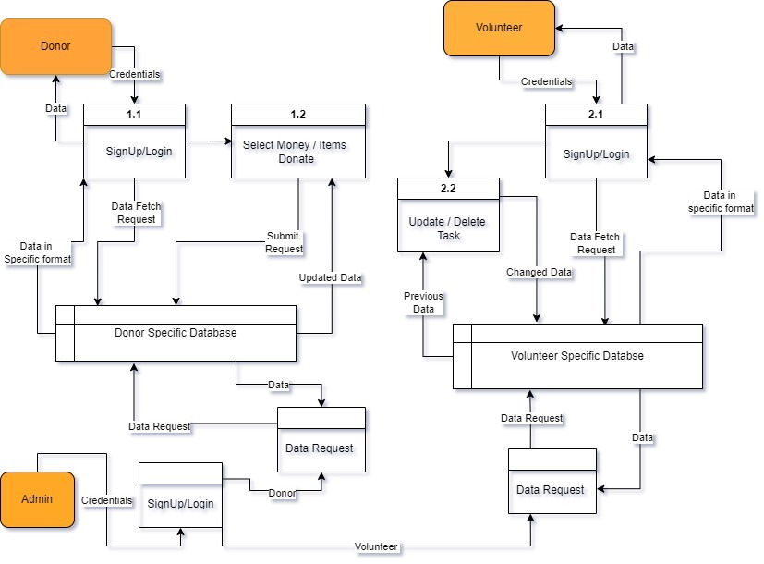
DFD
LEVEL 1

Slide 9
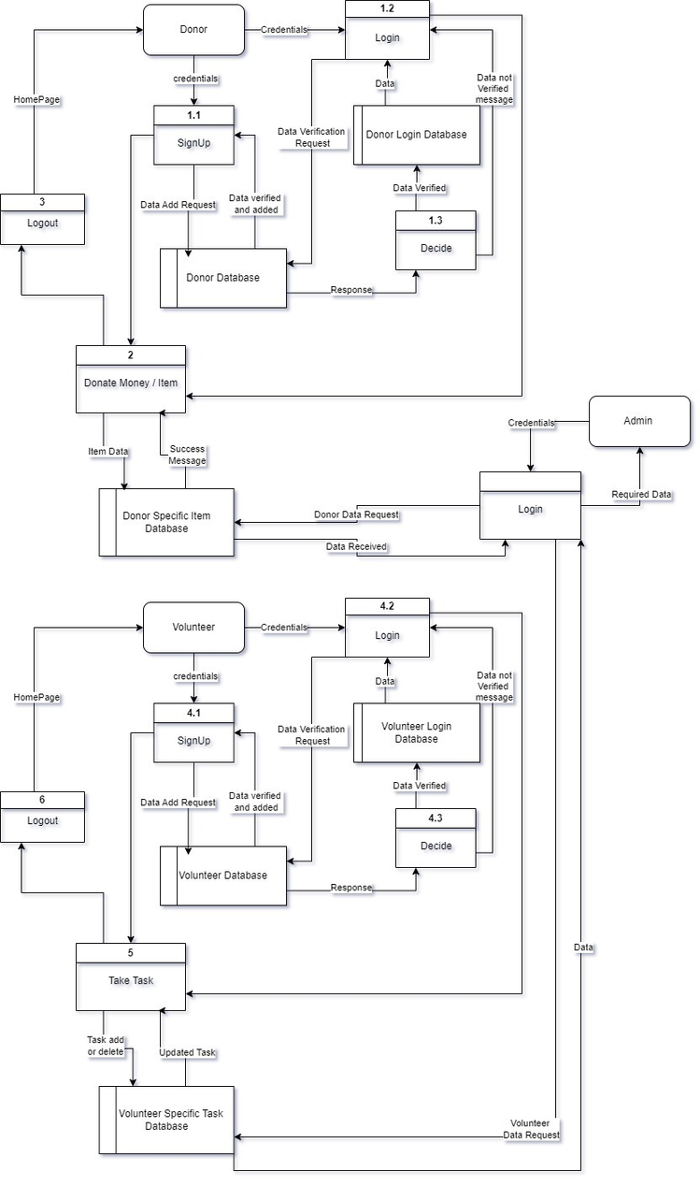
DFD
LEVEL 2

Slide 10
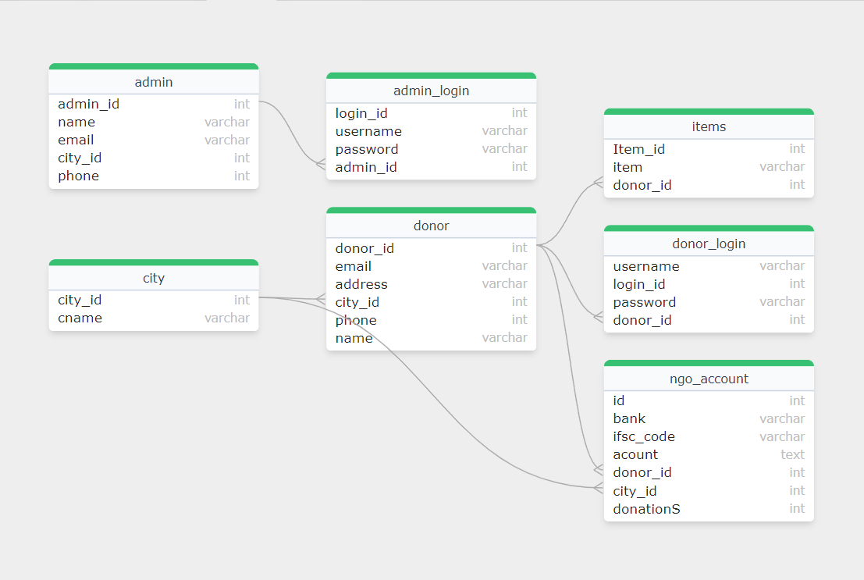
ER
DIAGRAM

Slide 11
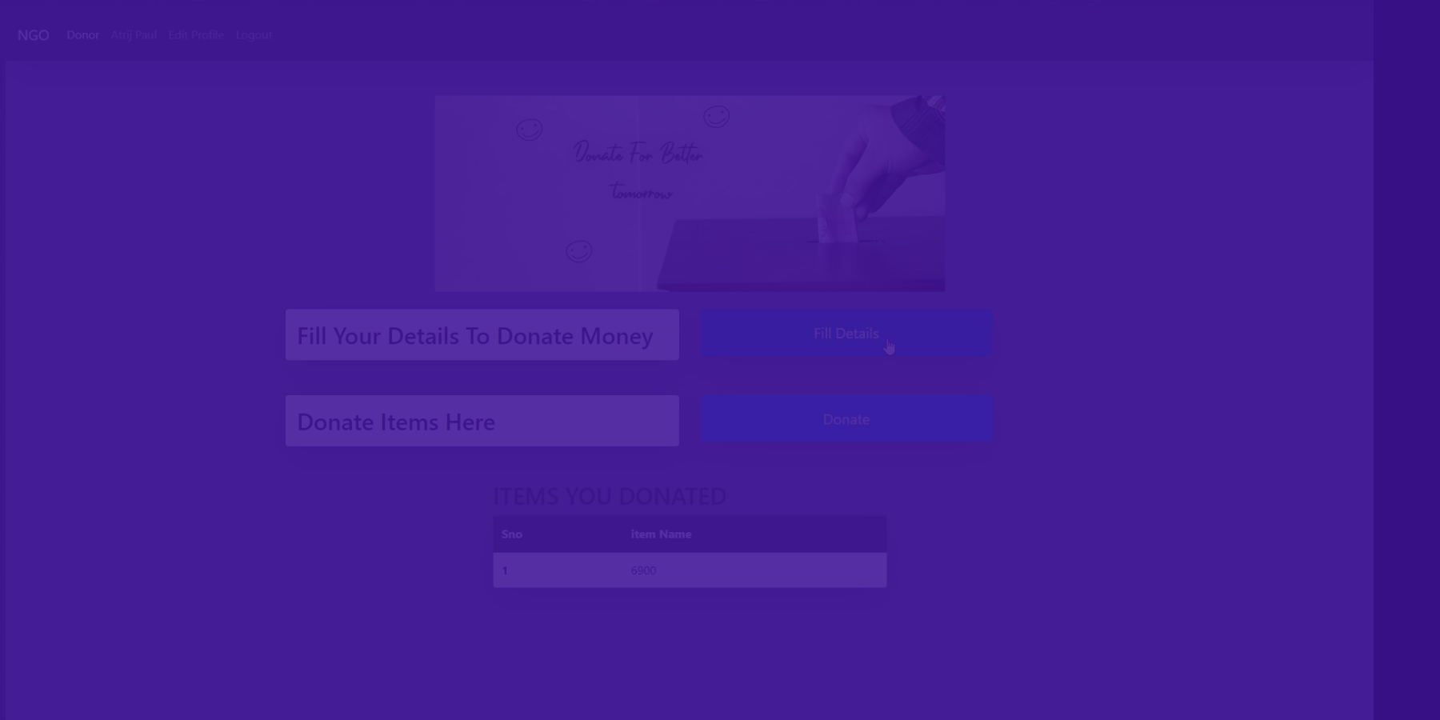
CONCLUSION
The Web-Based Charity Donation System aims to simplify the process of donating to charitable organizations. With robust features and a user-friendly interface, it is a valuable tool for both donors and administrators. Future enhancements will make the system even more effective and user-centric.

Slide 12


THANK YOU!

